Slide 1

Lake County Safety Council
Thursday, September 9 Meeting
Back to the Basics:
Lockout/Tagout &
Machine Guarding Safety

Slide 2

Event Sponsor
HzW Environmental Consultants

Slide 3


Event Sponsor
Lake Health
Occupational Services

Slide 4

Event Sponsor
Lake Health
Occupational Services

Slide 5
LOTO and Machine Guarding Basics
Welcome

Slide 6
Course Agenda
The following topics will be covered as part of this training:
  General review and discussion of the OSHA LOTO process
  LOTO program management
  Basics of machine guarding

Slide 7
Purpose of the Standard
29 CFR 1910.147
29 CFR 1926.417
OSHA - “To prevent the unexpected energization or startup of machines and equipment, or release of stored energy, to prevent workplace injuries during service and maintenance operations.”

Slide 8
When Does LOTO Apply?
During servicing or maintenance activities performed during normal production operations if:
An employee is required to remove or bypass machine guards or other safety devices;
An employee is required to place any part of his/her body into a machine’s danger zone;
Tasks performed near other moving equipment; or if
Maintenance or service tasks require close proximity to a guarded hazard area, while there is still potential for contact with the hazardous area of the machine (ex: loose clothing/hair falling into machine).

Slide 9
Machine Specific Procedures
Required for each piece of equipment or machine.
Must be accurate and up to date.
Points out each source of energy, the quantity, and where you release the energy and place the LOTO equipment.
It’s helpful to have a resource available when developing these such as a maintenance employee.
Notes:
It helps to use a consistent format for documenting and writing procedures. Brady Lockout Writer is a common software to assist with procedure development.

Slide 10
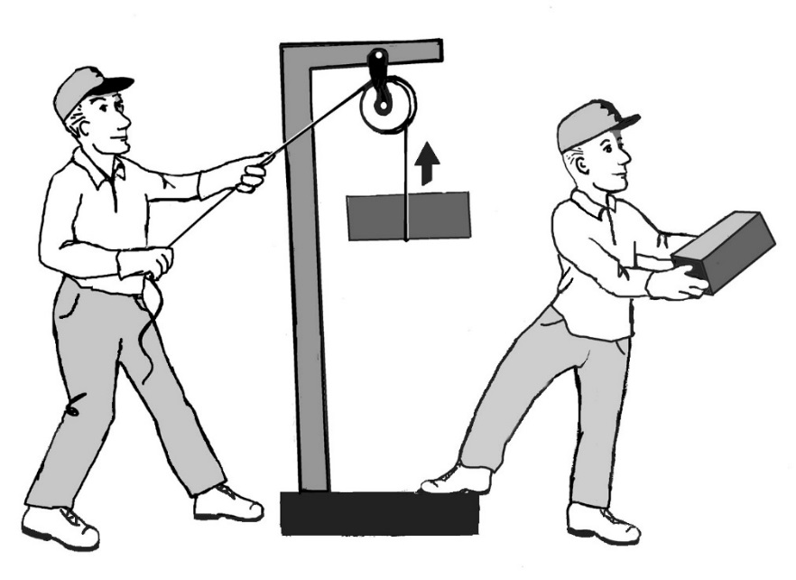
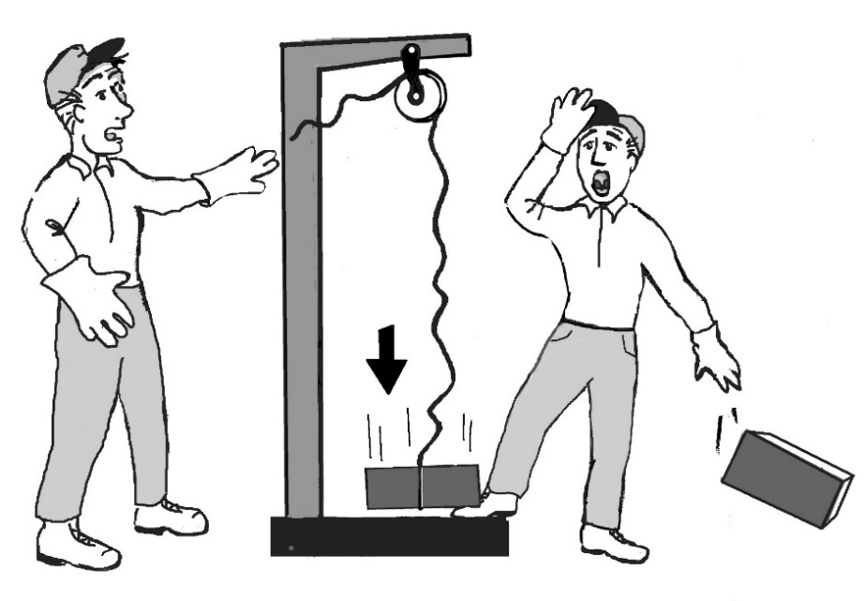
Zero Energy
Zero energy: Condition where all supplied and stored energy is removed, relieved, or blocked.
Potential energy can be converted to kinetic!

Slide 11
Common LOTO Failures
Employees do not lock out all isolation points or disconnects
Not enough lockout hardware is available for proper lockout/tagout
Lockout equipment is not feasible for given isolation points or disconnects
Not every employee participates in group lockout/tagout
Energy control procedures are not developed

Slide 12
LOTO Process
Notify affected employees
Shutdown equipment
Isolate equipment
Apply LOTO hardware
Perform service and maintenance work
Restarting equipment
Return to operation

Slide 13
Employee Training
Authorized:
  Trained to perform LOTO.
  Trained in the purpose and use of the energy control procedure
  Trained in the recognition of applicable hazardous energy sources.
  Trained in the methods and means necessary for energy isolation and control.
Affected:
  Trained in what to do when LOTO impacts their job.
  Instructed that attempts to restart or re-energize machines or equipment that is locked out is prohibited.
  Typically instructed in the limitations of their training (affected employees are not authorized to perform LOTO).

Slide 14
Continual Program management
Energy Control/LOTO Program should include the following:
Energy control procedures for every type and piece of equipment
Employee training as appropriate
Periodic assessments/reviews of authorized employees at least annually
Regular reviews of written LOTO procedures
Adequate supply of LOTO hardware
Develop and follow a LOTO removal policy

Slide 15
Machine Guarding
Three main categories of guarding:
  Barrier
  Device
  Proximity
  Not all equipment will have simple guarding solutions or easy fixes.
  NOTE: Manufacturers are not required to fully guard equipment that they sell to you!

Slide 16
Guarding Types
Barriers
Physical barrier to stop employees from reaching a hazard area (can be fixed or adjustable)
Device
Production controls or devices to stop machine (two-hand trip, light curtains, trip wire, etc.)
Proximity
Only applies vertically for unprotected fan blades (7’ above walking working surface)

Slide 17
Machine Guarding Purpose
Guarding is designed to permit the safe use of the equipment while preventing employee contact with hazard areas.
  Point of operation
  Rotating parts
  Access to other hazards
  Any equipment designed for a fixed location must be anchored or secured.

Slide 18
Special Considerations and tips
Perform assessments of each piece of equipment.
Evaluate for gaps in guarding that go beyond production or point of operation exposures.
Determine which exposures are production related or maintenance/service work.
Train employees to evaluate equipment for guarding concerns.
Provide tools or devices to keep employees hands away from hazard areas.

Slide 19
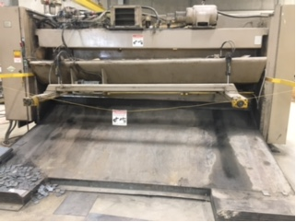

Slide 20
Questions?

